Slide 1

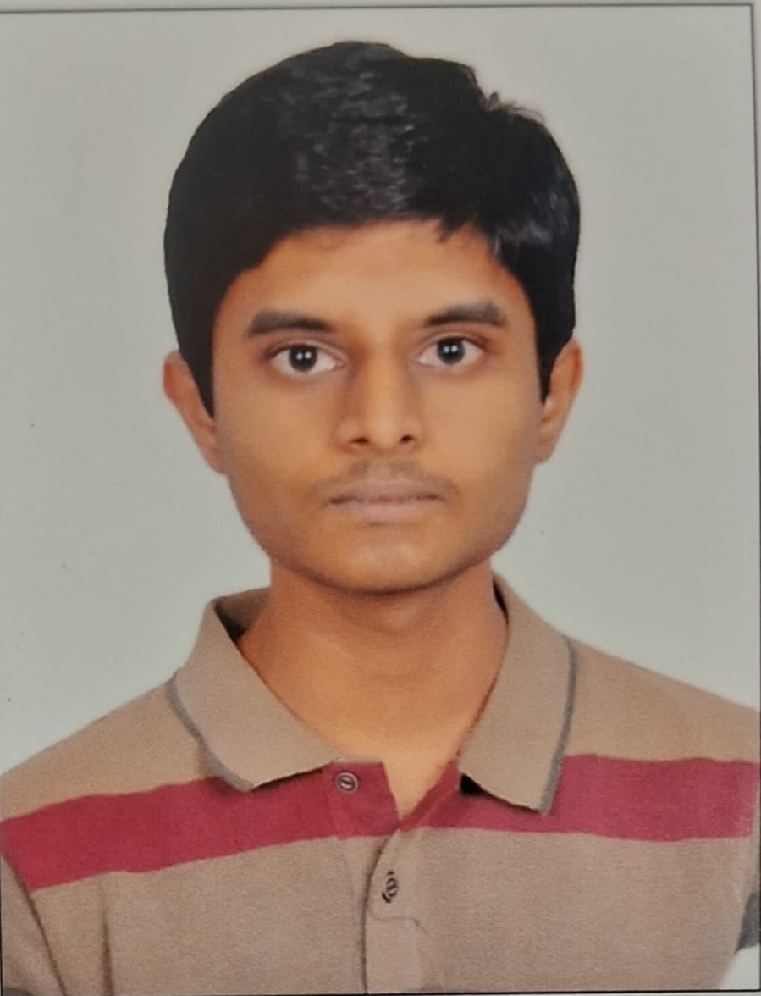

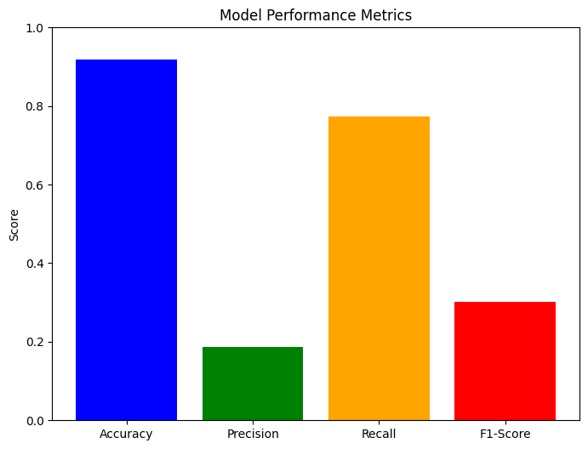
Project Name
Add Your Professional Profile Photo Here
Program Feedback
Project Short Summary
This program gave me a lot of insight and hands on knowledge of the real world projects in field of artificial intelligence and cloud platforms.
I developed a predictive model to identify heart disease risk using patient health indicators. The model was trained and evaluated on a dataset of 61,771 records of various metrics.
Aligeti Rajesh
aligetirajesh782@gmail.com
B V Raju Institute of Technology
#skillsbuild

